Slide 1
Preceptor Training
University of Cincinnati
Nurse Midwifery

Slide 2
Preceptors are a critical component of increasing the number of midwives in the US. Thank you for helping our profession reach a goal of 1,000 new midwives yearly!

Slide 3
Objectives
Define a preceptor
Identify the important role preceptors play in educating midwives
Be familiar with the Accreditation Commission for Midwifery Education (ACME) guidelines for precepting midwifery students
Demonstrate basic adult learning/teaching concepts and the different domains of learning
Identify keys and tips for efficient integration of clinical teaching and patient care (six microskills for clinical teaching)
Apply principles of therapeutic presence
Recognize what is meant by the Circle of Safety
Demonstrate positive and constructive feedback and evaluation skills
Effectively address issues with challenging students
Understand the role of the practicum faculty

Slide 4
Preceptors
Provides role modeling, support, and clinical learning experiences for students
Close the theory-practice gap
Assist students to achieve competency and self-efficacy
Teach clinical problem-solving
Provide clinical supervision
Understands key principles of Adult Learning Theory
Must have been in practice at least one year in their specialty

Slide 5
Adult Learning Theory Key Principles
Adults learn by “DOING”
Want active participation in learning rather than passive recipients of information
Adults learn best in informal situations
Bring past experiences into the current learning environment
Adults focus on realistic problems
Adults want guidance but are driven by internal motivation

Slide 6
Examples to Enhance Adult Learning
Talk with student before each clinical day to identify learning goals, go over schedule, and assign appropriate patients
Use any free time to create informal learning opportunities
Provide on-going feedback
Talk at the end of each clinical day by asking what went well, what could have gone better, and goals for future sessions

Slide 7
Training the Next Generation of Midwives
Preceptors serve as:
Role models
Teacher
Coach
Evaluator

Slide 8
Qualities of a Good Preceptor
Leadership
Strong communication and listening skills
Positive conflict management
Ability to evaluate based on standards
Ability to facilitate critical reasoning
Ability to self-reflect
Maintains FERPA (maintaining student confidentiality)

Slide 9
3 Main Functions of a Preceptor
Orientation
Teaching
Feedback

Slide 10
Accreditation Commission of for Midwifery Education (ACME) Guidelines for Preceptors
Students must be supervised by a CNM/CM prepared clinician ≥ 50% of time
Evidence that the preceptor meets the academic institution’s requirements
Evidence of passage of appropriate national certification exam
Evidence of unencumbered, current state and professional licensure
Evidence that preceptor is prepared for teaching and has competence commensurate with the teaching assignment

Slide 11
Start the Semester
Faculty will send preceptors copies of:
Course syllabus, Formative Evaluation Tool, Preceptor Training materials, their contact information
Faculty will request that preceptor provide them with best times to communicate about student progression

Slide 12
On First Day of Clinical Rotation….
Orient student to the facility (i.e. bathroom, call room, microscope, supply closet, etc.)
Introduce student to staff (i.e. nurses, medical assistant, office manager, MD colleagues, etc.)
Orient student to type of charting used at facility (i.e. EMR vs paper); If appropriate, instruct student how they can get access to EMR. If the institution allow, students are expected to chart in EMR

Slide 13
Learning Domains
Cognitive
Knowledge base
“Knowing”
Psychomotor
Procedural skills
“Doing”
Affective
Moral reasoning, value-based behavior
“Being”

Slide 14
Cognitive Domain $−$ “Knowing”
Problem solving
“Critical Thinking”
Acquiring the knowledge base and applying it appropriately
Analysis
Can examine a situation and break it into parts
Synthesis
Can compile information in a new pattern, propose alternative solutions
Evaluation
Judge our own effectiveness
Make adjustments as needed

Slide 15
Teaching Techniques: Cognitive Domain
Properly phrased questions
Freedom to explore and learn within boundaries of safety
Rationale sharing
SNM and CNM must have rationale for plan

Slide 16
Stimulating Cognitive Learning: Knowledge
What is…?
Why did…?
When did…?
How would you show…?
How would your explain…?
How would you describe…?
Can you list…?

Slide 17
Stimulating Cognitive Learning: Higher Levels of Critical Thinking
What would result if…?
What conclusions can you draw?
What alternatives could you consider?
What is your rationale for …?
What could you change…?
Was…successful?

Slide 18
Evaluation of Cognitive Domain
Critical thinking at all times
Following steps of the midwifery management plan
Application of theory base to clinical practice
Effective communication skills
Eliciting rationale

Slide 19
Cognitive Difficulties
Critical thinking lacking or inconsistent
Data collection incomplete, unorganized
Decisions inaccurate
Based on incomplete data
Not made at all
Unable to determine appropriate role
Plan of care incomplete, inaccurate
Client not included, alternatives not considered
Care given:
Incomplete, inappropriate
Unable or unwilling to evaluate
Self, plan of care
Inaccurate, overconfident, hypercritical

Slide 20
Reasons Why Students May Have Cognitive Difficulties
Unfamiliarity with clinical setting, routines, or preceptor expectations
Insufficient didactic knowledge
Inability to understand or apply knowledge
Learning disability
NOTE: Preceptor should contact faculty right away with concerns so that measures can be taken to identify and correct the issue

Slide 21
Psychomotor Domain $−$ “Doing”
Skills acquisition- NOTE: UC NM students learn basic skills on-campus with simulation and standardized patients prior to their clinical rotation
Teaching techniques
Demo/return demo
Skills lab
Use of models
Evaluation
Accuracy
Time utilization
Patient response

Slide 22
Psychomotor Difficulties
Hands don’t work well
Trembling, klutzy
Hand-eye coordination lacking
Can’t master skill
Rough, causes undo discomfort
Efficiency and speed lacking
Tongue engages before brain

Slide 23
Affective Domain $−$ “Feeling”
Social knowledge
Learning of attitudes and values of the profession
Accountability
Professionalism
Holism
Family-centeredness
Self-determination

Slide 24
Red Flags for an Affective Domain Problem
Breaching patient confidentiality
Attendance issues
Poor record keeping
Not being receptor to feedback
Difficulty communicating with other healthcare professional

Slide 25
Affective Difficulties
Unwilling to make decision
Fear of responsibility
Unwilling to assume accountability
For actions- care
Self evaluation
Does not include client in care
No family input
Lack of informed consent
Lack of integrity
Provides care when in spite of not knowing what to do
Does not communicate learning deficits to preceptor
Dishonest with clients or colleagues
Lack of common sense
“Searches for zebras instead of cows”

Slide 26
Teaching Methods: Affective Domain
Role modeling
Role play
Discussion of feelings, reactions
Values clarification exercises
ACNM Documents
Standards of Practice
Code of Ethics
Position Statements

Slide 27
Evaluation of the Affective Domain
Behavior with client, staff, preceptor
Willingness to make decisions
Accountability for care
Commitment to midwifery philosophy
Honesty and integrity
“I don’t know but I will find out”
Common sense

Slide 28
Teaching Strategies
Case presentations (cognitive/affective)
Simulation/talking through (cognitive/affective)
Directed questions/rationale requests (cognitive/affective)
Practice (psychomotor)
Demonstration/return demonstration (psychomotor)
Observation (affective)
Modeling accountability, autonomy (affective)
Self-evaluation, reflection, self discovery (affective)

Slide 29
Domains of Learning in Clinical Objectives
Student obtains, evaluates, and records pertinent data for complete assessment of the client
Chart review (cognitive)
History (cognitive, affective)
PE (cognitive, psychomotor, affective)
Lab (cognitive)
Explains to client (affective, cognitive)

Slide 30
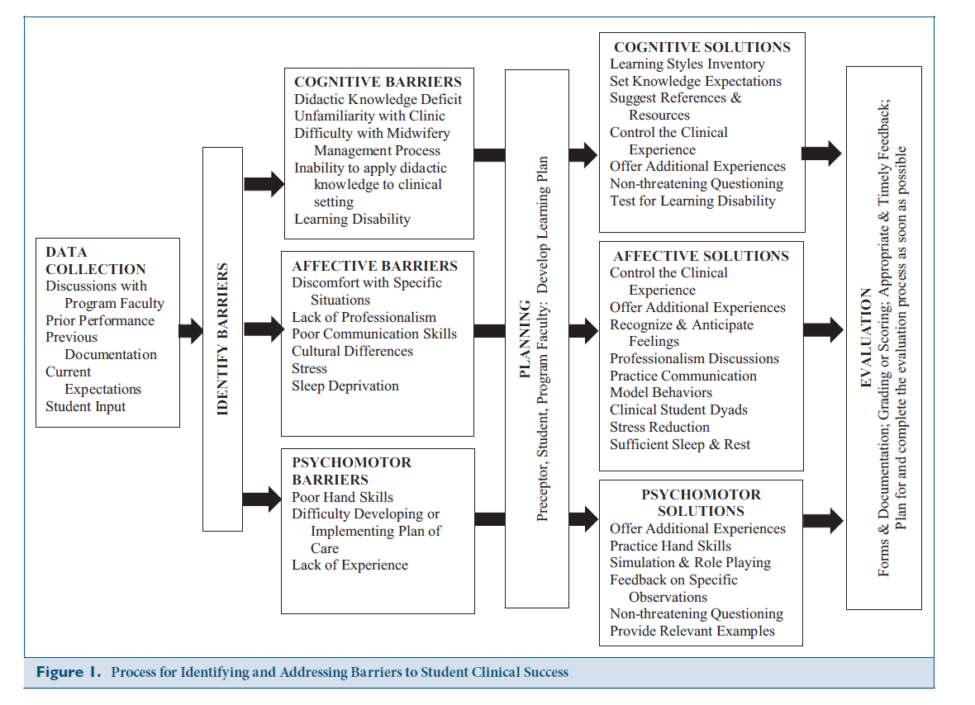

Slide 31
Facilitation of Learning
“Learning is facilitated by a climate in which participants see themselves as mutual helpers rather than competitors, in which there is mutual trust, in which people feel safe and supported and in which everyone feels respected”
$−$ Knowles

Slide 32
Six Microskills for Clinical Teaching
Get a commitment
Probe for supporting evidence
Teach general principles
Reinforce what was done right
Correct mistakes
Identify next learning steps

Slide 33
Microskill 1: Get a Commitment
The learner is encouraged to make a commitment to a diagnosis, work-up, and/or plan
When learner presents facts and then stops, resist the urge to fill in the blanks
Student:
“I finished examining a 16 yo girl. She reports pain with urination for the past few days. She has never had a UTI. She denies abdominal pain, fever, or blood in urine. She reports LMP a few weeks ago. I wasn’t sure if I was supposed to ask those kinds of questions. She is here with questions. She is here with her mother.”

Slide 34
Microskill 2: Probe for Supporting Evidence
Help the learner reflect upon the mental processes used to arrive at the decision
Identify what the learner does and does not know
The learner commits to a stance and looks to the teacher for confirmation; Suppress the urge to pass judgement
Student:
“On physical exam, she looed well to me. She was afebrile and the rest of her vital signs were O.K. Her HEENT exam was normal. Her lungs were clear and her heart was regular without any murmurs. Her abdomen was soft and not tender and I didn’t think her spleen or liver were enlarged. That’s all I examined.”

Slide 35
Microskill 2: Sample Questions
Examples:
“What were the main findings that led to your diagnosis?”
“I’m interested in understanding how you have come to this conclusion.”
Why did you choose the medication given the availability of others.”
Not:
“Name the 6 most likely causes of _______.”
“Don’t you have any other ideas?”

Slide 36
Microskill 3: Teach General Principles
Keep it to 1-3 general rules at most.
Keep information general, avoiding anecdotes and idiosyncratic preferences.
The teacher can skip this step when appropriate
Preceptor:
“ The UTI is a logical possibility but we don’t have adequate information to confirm the diagnosis. We need a more complete physical examination, particularly of the lower abdomen and external genitalia. We also need a sexual history. Has she recently become sexually active?”

Slide 37
Microskill 3: Examples
Examples:
“Typically there are two main treatment options.”
“Important factors to consider are….”
Not:
“I’ve always done it this way.”
“This patient needs Lasix”

Slide 38
Microskill 4: Reinforce What Was Done Right
Competencies must be repeatedly rewarded and reinforced
Build upon the learner’s professional self-esteem
Focus on specific behaviors
Preceptor:
“You identified the most probable concerns in this case but you need to complete the physical exam and get a sexual history. Without more information, we can’t be sure of what we have. Do you want me to model how to take a sexual history and do a pelvic examination or would you like me to observe you do them?”

Slide 39
Microskill 4: Examples
Examples:
“You did a really good job of prioritizing that patient’s long list of problems at today’s visit.”
You were conscious of the patient’s financial situation and cost in selecting the most appropriate antibiotic. This will help the patient be compliant with medication.
Not
“Good job!”

Slide 40
Microskill 5: Correct Mistakes
An appropriate time and place must be chosen
Ask the learner to critique their own performance first
Focus on how to correct the problem or avoid it in the future

Slide 41
Microskill 5: Examples
Example
“You may be right that this child’s symptoms are due to a URI. But without checking the ears, you may be overlooking an otitis media.”
“There are more cost-effective approaches to treating ___________.”
Not
“Why don’t you read about that later.”
“That whole case was handled badly.”

Slide 42
Microskill 6: Identify Next Learning Steps
Fosters self-directed learning and facilitates the learner identifying their own learning needs
Offer specific resources as appropriate. The idea is for the teacher to role model their own learning approaches
Agree upon an action plan

Slide 43
Microskill 6: Examples
What do you think you need to learn more about?
That’s a good topic to research. I tend to use ___________ as a first step in looking up this type of information.
Let’s agree to discuss this again on Friday after you have had time to research this.

Slide 44
Therapeutic Presence
Emotional support
Tangible Assistance
Providing Explanation
A Hallmark of Midwifery in ALL Scope of Practice

Slide 45
Circle of Safety
Knowing your circle of safety is the first step:
Being clear in what you are comfortable with
Being clear with the student what your boundaries might be
Ask student where they are within this circle:
Do they have boundaries?
Staying within your circle is appropriate … unless there is no progress:
For example: … happy to watch again and again as you suture

Slide 46
Feedback vs. Evaluation
Feedback
Evaluation
Coaching
Formative
Synchronous
Professional development
Judging
Summative
After the fact
Quality assurance

Slide 47
Guidelines for Effective Feedback
Establish when and how feedback will be given
Ideally: every encounter with learner
Realistically: regular intervals
Safe, neutral environment
Solicit learner’s version of events
Use “I” statements

Slide 48
Guidelines for Effective Feedback
Break the ice:
“How do you think you did?”
“What aspects need improvement?”
Focus on changeable behaviors
Give reasonable amounts of “pearls”
Keep it performance based
Check for understanding
Plan follow-up action

Slide 49
Guidelines for Evaluation
Formal system with written standards, written evaluation procedures (see syllabus for evaluation forms)
Documentation of evaluations are written and signed, with established corrective plans as needed.
Communication is vital:
Frequent formative evaluations (once every 2 weeks)
Final summative evaluations with faculty and student

Slide 51
Dealing with Challenging Students
Identify early on and get faculty involved
Know the course expectations
Orient the student well
Set clear expectations and goals
Determine the student’s goals and expectations
REASSESS, REASSESS

Slide 52
Dealing With Challenging Students
Pay attention to your hunches and clues early on
Don’t wait to intervene to get help
Give specific feedback early and watch response
Initiate SOAP format for analysis (next slide)

Slide 53
An Approach to Problem Interactions
Subjective
What do you/others think and say?
What is the description of the “history” of the issues?
Objective
What are the specific behaviors that are observed that is concerning?
Assessment
Your differential diagnosis (your possible explanations for the problem – is it a cognitive issue? Affective issue? Environmental? Etc.)
Plan
Gather more data?
Get help?
What will your strategy be with dealing with the issue

Slide 54
Faculty Support for Your Work as Preceptors
Brainstorm ideas to help create solutions
Assist with concerns about documentation of problem and follow-through on student’s evaluation forms
Be available for ongoing discussion of student’s progress
Encourage student-preceptor debriefing at the end of each clinical day
Encourage prompt completion of formative evaluations every two weeks and completion of summative evaluation at end of term

Slide 55
Review Question 1
When a student is extremely nervous about performing a procedure, which of the following techniques would enhance student self-efficacy?
Listening and then reassuring
Patience and waiting until the student is ready
Verbal persuasion and providing a pep talk

Slide 56
Review Question 1 Answer:
When a student is extremely nervous about performing a procedure, which of the following techniques would enhance self-efficacy?
Listening and then reassuring
Patience and waiting until the student is ready
Verbal persuasion and providing a pep talk

Slide 57
Review Question 2
What are the major roles the preceptor engages in when working with students?

Slide 58
Review Question 2 Answer
What are the major roles the preceptor engages in when working with students:
Role model
Teacher
Coach
Evaluator

Slide 59
Review Question 3
Which learning domain appears to be problematic for a student who has difficulty inserting intrauterine devices?
Affective
Cognitive
Psychomotor

Slide 60
Review Question 3 Answer
Which learning domain appears to be problematic for a student who has difficulty inserting intrauterine devices?
Affective
Cognitive
Psychomotor

Slide 61
THANK YOU!
Thank you for your contribution to the training of future certified nurse-midwives!

Slide 62
References
Dyer, J.M. & Latendresse, G. (2016). Identifying and addressing problems for student progression in midwifery clinical education. Journal of Midwifery & Women’s Health, 61(1), S28-S36.
Krause, S.A. (2016). Precepting challenge: helping the student attain the affective skills of a good midwife. Journal of Midwifery & Women’s Health, 61(1), S37-S45.
Lazarus, J. (2016). Precepting 101: teaching strategies and tips for success for preceptors. Journal of Midwifery & Women’s Health, 61(1), S11-S21.
Myers, K& Chou, C.L. (2016). Collaborative and biodirectional feedback between students and clinical preceptors: promoting effective communication skills on health care teams. Journal of Midwifery & Women’s Health, 61(1), S22-S27.

